Slide 1


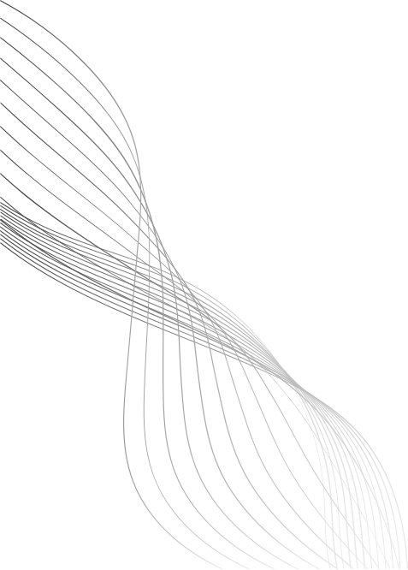

SCHOOL OF COMPUTER ENGINEERING
AI SIGN LANGUAGE AVATAR GENERATOR
Group Members:
Ganesh Atre(202201040068)
Sahil Chalotra(202201040072)
Siddhesh Kotwal (202201040095)
Dhiraj Mundane (202201040211)
Guided By:
Prof.Savita Mane
School Of Computer Engg. Engineering

Slide 2
PROBLEM STATEMENT
Deaf and Hard-of-Hearing (HOH) individuals often face communication barriers, and captions alone are not enough. A real-time AI avatar that translates speech or text into sign language can bridge this gap and promote inclusivity.

Slide 3
Objectives
  To develop a real-time AI avatar that translates text into American Sign Language (ASL).
  To ensure natural, smooth, and culturally accurate gesture generation.
  To synchronize hand movements, facial expressions, and body posture for realistic communication.
  To minimize latency for seamless real-time interaction.
  To train and evaluate the system using benchmark ASL dataset RWTH-PHOENIX-Weather-2014T.
  To lay the foundation for scalability towards multi-lingual sign languages.

Slide 4
Literature Survey

Slide 5
S.NO | TITLE | YEAR | Description | Ideas
1. | SignDiff: Diffusion Model for American Sign Language Production | 2025 | Introduces SignDiff, a diffusion-based model for ASL that directly converts text to poses and realistic videos, achieving state-of-the-art results | Use diffusion models for Gloss→Pose generation to get stable, diverse, high-fidelity gesture sequences.
2. | Human-Centered Editable Speech-to-Sign-Language Generation | 2025 | Real-time speech-to-sign system with editable JSON outputs and human-in-the-loop feedback. Ensures low latency, personalization, and higher user trust | Adopt low-latency design, applied in optimization and user studies.

Slide 6
S.NO | TITLE | YEAR | Description | Ideas
3. | Speech and Text to Sign Language Translator Using 3D Avatar | 2024 | Translates speech/text to Indian Sign Language (ISL) with NLP and a 3D avatar, offering a web interface. Future work: VR/AR and facial expressions. | Follow the NLP → avatar rendering → web UI integration pattern for front-end and pipeline design.
4. | A Speech-driven Sign Language Avatar Animation System for Hearing Impaired Applications | 2022 | A system that converts speech to sign avatars by combining NLP, gesture animation, and facial synthesis, deployed as apps for interpretation and virtual anchors | Use modular architecture: linguistic mapping + gesture animation + facial synchronization (Transformer, Diffusion/GAN, VAE/Pose Transformer).

Slide 7
S.NO | TITLE | YEAR | Description | Ideas
5. | Sign Language Transformers: Joint End-to-End Sign Language Recognition and Translation | 2020/2022 | A transformer model jointly performs sign recognition and translation, achieving top results on PHOENIX14T dataset. | Apply Transformer/attention for robust Text→Gloss mapping and token–gloss alignment.
6. | Everybody Sign Now: Translating Spoken Language to Photo Realistic Sign Language Video | 2020 | Proposes SIGNGAN, generating photo-realistic sign videos from speech using transformers and pose-to-video synthesis. Improves realism over avatar-based systems. | Use pose-conditioned generation ideas for the final pose→avatar rendering stage to improve visual realism.

Slide 8
Model Selection
Model 1 - VQ-VAE (The “Motion Dictionary”)
Role:
Learns a discrete motion codebook of fundamental sign language movements.
Reason:
Instead of translating directly, it compresses real sign language motion data into reusable motion “tokens.” These tokens act like the phonemes of motion, forming the foundation for all generated gestures.

Slide 9
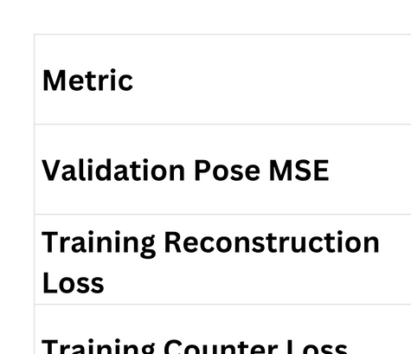
Evaluation Metrics

Slide 10
Model 2 - Transformer (The “Translator”)
Role:
Translates input text (e.g., English) into a sequence of motion codes from the VQ-VAE dictionary.
Reason:
The Transformer’s encoder–decoder architecture excels at capturing long-range dependencies, making it ideal for mapping natural language to motion representations.

Slide 11
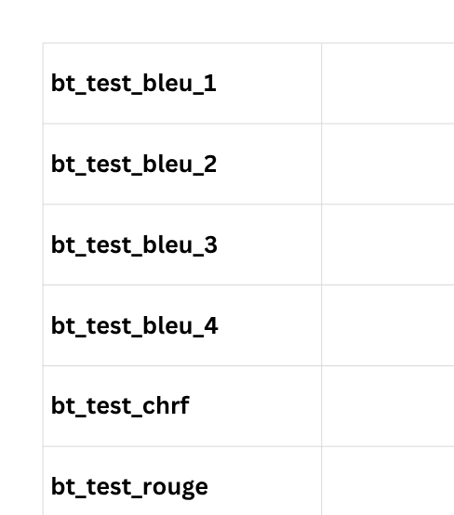
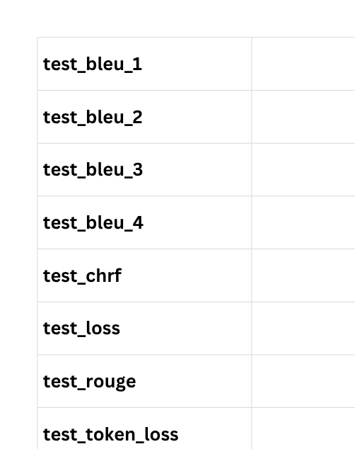
Evaluation Metrics

Slide 12
Model 3 - GAN (The “Style Refiner”)
Role:
Refines the coarse, codebook-based poses from the VQ-VAE and Transformer pipeline into smoother, more human-like motion.
Reason:
The GAN (PatchGAN) adversarially trains a Generator to make robotic motions appear fluid and realistic, using both adversarial and L1 losses.

Slide 13
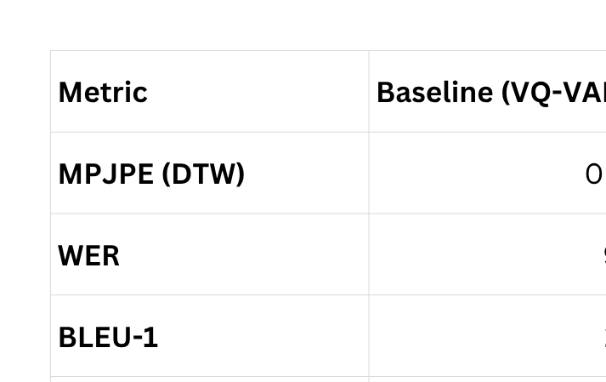
Evaluation Metrics

Slide 14
Model 4 - Diffusion Refiner (The “Denoising Refiner”)
Role:
Synchronizes the fine-grained movements of the face, hands, and body to produce a cohesive and natural performance.
Reason
Reason:
The Pose Transformer's attention-based architecture allows it to model the complex interdependencies between different body parts, ensuring a lifelike and expressive avatar that mirrors the natural coordination of a human signer.

Slide 15
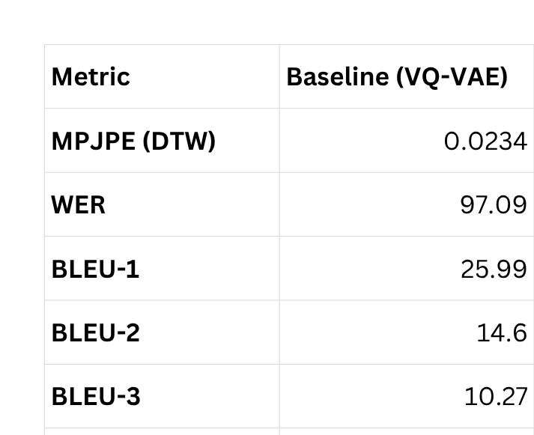
Evaluation Metrics

Slide 16
System Architecture

Slide 17
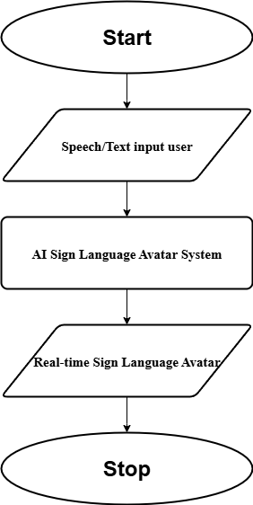

Slide 18
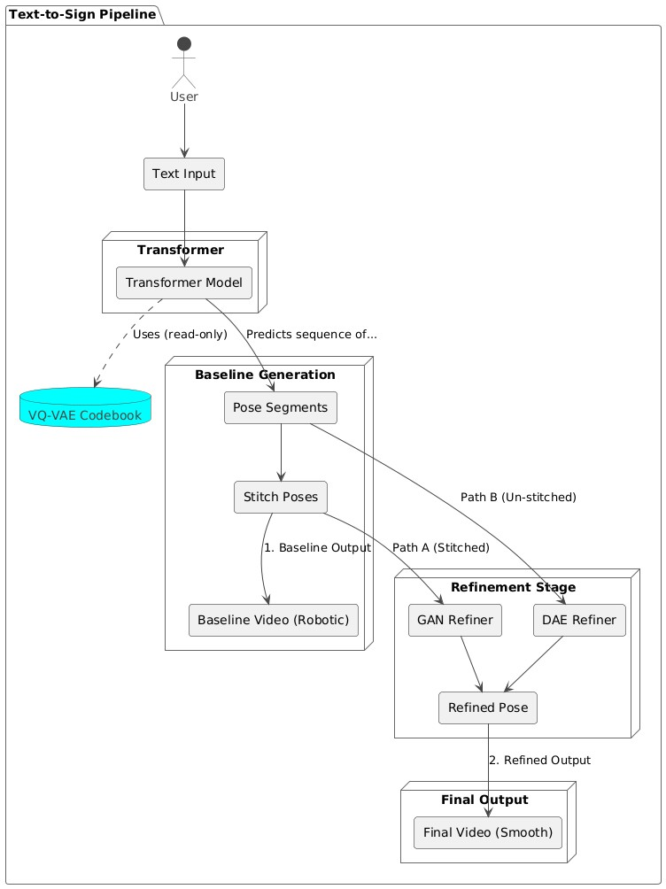

Slide 19
Mathematical Formulation
1.VQ-VAE (Motion Dictionary Learning)
Equation:
î = D(q(E(x)))
Loss Function:
Lrec = ||x - î||2
Where:
· x: Original input motion sequence (pose frames from real signer).
. E(x): Encoder output - latent motion representation.
. q(.): Vector quantization function - maps latent vector to nearest code in the learned codebook.
. D(.): Decoder - reconstructs the motion sequence from the quantized vector.
· î: Reconstructed (predicted) motion sequence.
. Lrec: Reconstruction loss (Mean Squared Error), ensures the decoded motion matches the original.

Slide 20


Mathematical Formulation
2 .Transformer (Text → Motion Code Translation)
Equation:
Loss Function:
where,
  T: Input text sequence
  C=[c1,c2,...,cn]:Sequence of motion codes predicted by the model.
  ct: Motion code predicted at time step t.
  c<t​: All previous codes before time t.
  P(C∣T): Probability of generating the correct motion code sequence given text..
  Ltrans​: Cross-Entropy Loss, measures translation accuracy.

Slide 21


Mathematical Formulation
3.GAN (Pose Refinement and Realism Enhancement)
Generator Loss:
Discriminator Loss:
Where:
  X: Generated (robotic) pose sequence from VQ-VAE + Transformer.
  Y: Real pose sequence from dataset.
  G(X): Generator output — refined pose sequence.
  D(⋅): Discriminator — distinguishes between real and refined poses.
  Ladv​: Adversarial loss encouraging realism.
  L1​(G(X),Y): L1 reconstruction loss maintaining semantic accuracy.
  λ: Weight balancing realism and content preservation.

Slide 22

Mathematical Formulation
4.Diffusion Refiner (Denoising & Smoothing)
Equation:
Where:
  Xnoisy​: “Noisy” or “robotic” motion sequence generated from VQ-VAE.
  Xclean​: Ground-truth clean motion from dataset.
  R(⋅): Refiner (Denoising Autoencoder) network that predicts the clean motion.
  LDAE​: L1 loss ensuring minimal difference between refined and real motion.

Slide 23
Implementation
Dataset Requirements:
  Large paired datasets of text/audio ↔ gloss ↔ motion capture of signers.
  Synthetic augmentation to cover low-resource signs.
Pipeline Execution Order:
  Speech/Text → VQ-VAE Decoder → Motion Code Sequence
  Motion Codes → Transformer → Preliminary Pose Sequence
  Preliminary Poses → GAN/Diffusion Refiner → Realistic Human-like Motion
  Refined Motion → Avatar Renderer → Final Sign Language Animation
Performance Metrics:
  Translation accuracy (BLEU/ROUGE for text–gloss).
  Realism (FID score for generated avatar).
  User study (intelligibility + naturalness rated by Deaf community).

Slide 24
System Integration
Front-End Layer:
  Input: Text (ASR system).
  Output: 3D/2D avatar rendered in real-time.
Model Integration Layer:
  Pipeline combining all 4 models sequentially.
  Optimized with ONNX/TensorRT for deployment.
Back-End Layer:
  Dataset management, cloud inference, user corrections, and updates.
Deployment Options:
  Web App: Browser-based for quick accessibility.
  Mobile App: Lightweight avatar rendering.
  API Service: For integration into platforms like Zoom, MS Teams, or classrooms.

Slide 25
Model Comparitive Analysis

Slide 26
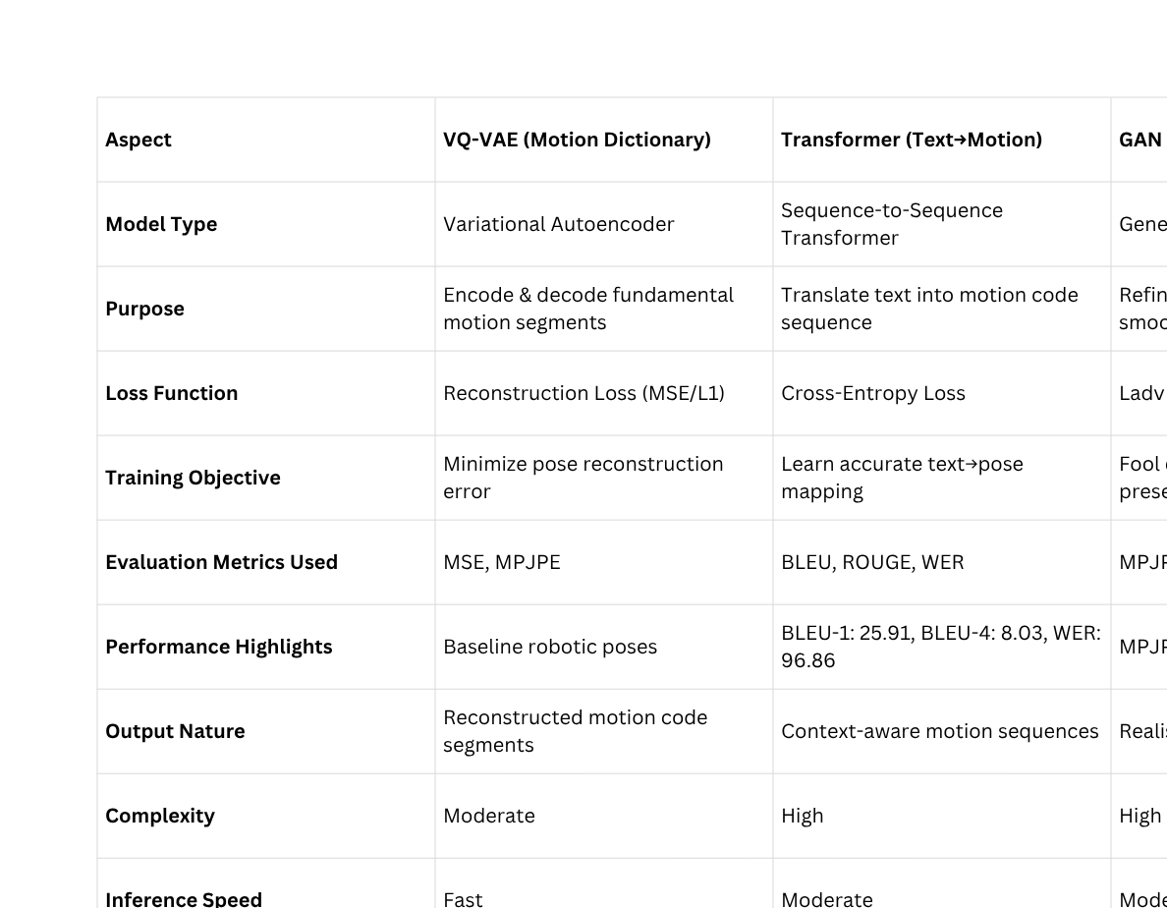

Slide 27
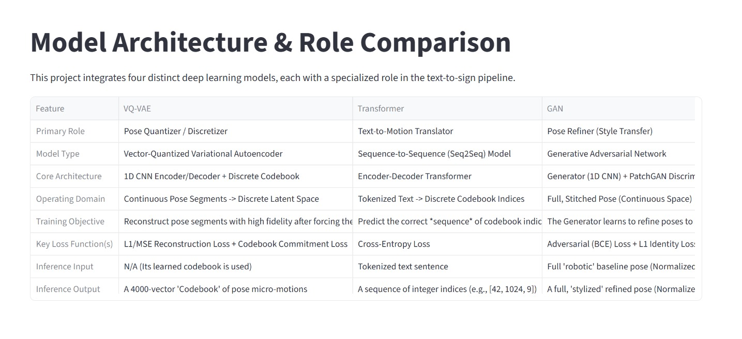

Slide 28
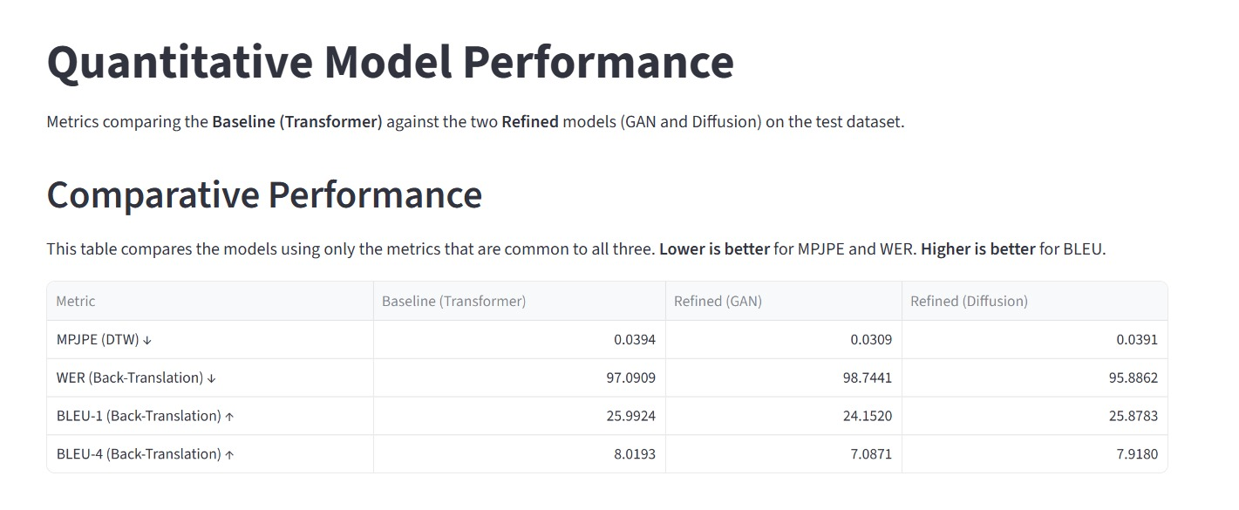

Slide 29
Model Comparitive Analysis

Slide 30
Conclusion
Previous research in sign language production has developed systems using speech-to-text with NLP and 3D avatars, or speech-driven avatars with gesture and facial animation. More advanced works such as SIGNGAN and SignDiff employed GANs and diffusion models to achieve more realistic outputs, but still faced challenges like jerky motion, limited facial synchronization, and reliance on a single model.
In contrast, this project proposes a hybrid pipeline of four generative AI models—a Transformer for gloss translation, GAN/Diffusion for gesture generation, VAE for smoothing, and Pose Transformer for synchronization. This design ensures real-time, natural, and accurate avatar signing, addressing prior limitations and paving the way for future multi-lingual, VR/AR, and emotion-aware integration.

